Slide 1

Lecture 4: Process, Thread, Task
Topics: Process, Thread, Worker Thread, Async Task

Slide 2
Today’s class:
Concepts
(Lecture)
What is a process? Thread?
In Android?
Problem
(code)
What is the limit of the main thread?
Creating the problem scenario.
Back-to-Concepts
(lecture)
Running on UI thread.
Async Task
Solution
(code: all)
Create the problem scenario
Use Async Task

Slide 3
Concepts

Slide 4
Program vs. Process
A program is a set of instructions + data stored in an executable image. (passive)
A process is a program “in action” (dynamic)
Program counter
CPU registers
Stacks
States
For more details:
http://www.tldp.org/LDP/tlk/kernel/processes.html
Notes:
Process:
Runs in own virtual address space.
Uses secure, kernel managed mechanism to interact with other processes.

Slide 5
Program vs. Process
Chai Tea Recipe:
1. Add water in pan. 2. Add sugar, tea leaves, spices. 3. Bring to boil and simmer. 4. Add milk. 5. Bring to boil and simmer. 6. Strain tea in teapot.
Program or Process?

Slide 6
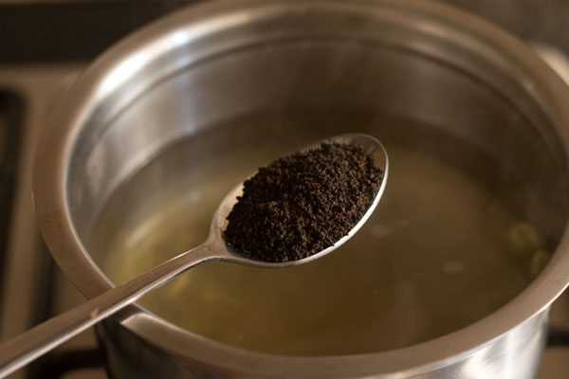
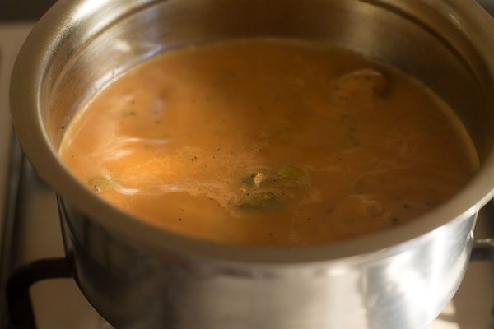
Program vs. Process
Process:
1. Add water in pan. 2. Add sugar, tea leaves, spices. 3. Bring to boil and simmer. 4. Add milk. 5. Bring to boil and simmer. 6. Strain tea in teapot.
Process:
1. Add water in pan. 2. Add sugar, tea leaves, spices. 3. Bring to boil and simmer. 4. Add milk. 5. Bring to boil and simmer. 6. Strain tea in teapot.

Slide 7
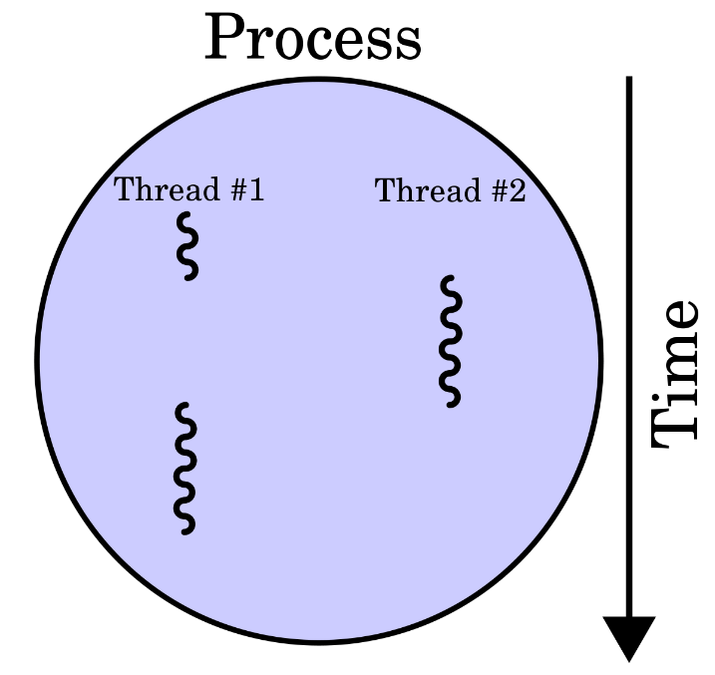
Thread
A Thread is a flow of execution inside a process.
Threads in a process share the same virtual memory address space.
Context switching between threads are faster than context switching between processes.
1:1 mapping between kernel space and user space threads.

Slide 8
Android Processes and Threads
Default Behavior:
All components of an App run in the same thread (the main/UI thread) and the same process.
C1
C2
C3
T
P
Default
However, you can:
Arrange for components to run in different processes.
Create multiple threads per process.
C1
C2
C3
T1
T2
P1
P2
It’s possible

Slide 9
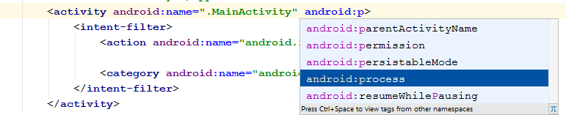
android:process
Specify android:process in AndroidManifest.xml:
<activity>, <service>, <receiver>, <provider>
<application> (all components; same UID and certificate)

Slide 10

Process creation and removal
Creation: When the first component of an App is run and there is currently no process for that App.
Removal: Remove old processes to reclaim memory for new or more important processes.
Which process should be killed?

Slide 11
Process Hierarchy
From High to Low Priority
Priority | Type | Description
1 | Foreground | On-going interactions; activity, service, broadcast
2 | Visible | Not in the foreground, but visible
3 | Service | Playing music, downloading stuffs
4 | Background | onStop() called, not visible, LRU kill
5 | Empty | Lowest priority
Kill them first
Visible
Activity
Classified as Visible Process
Service
P
Notes:
Foreground (highest priority, interactions on-going, can be Activity, Service, Broadcast receiver)
Visible (not foreground but visible)
Service (startService, playing music/downloads)
Background (onStop called, no visible, LRU kill)
Empty (lowest priority)

Slide 12

Main Thread
Created when an App is launched
Often called the UI thread
Dispatched events to widgets
android.widget and android.view package

Slide 13
Problem
Keeping Apps Responsive

Slide 14

Problem: keeping an App responsive
Testing the limit of the UI thread:
How big a task we should do in UI thread?
How big a task we can do in UI thread?
What is the alternative?
What is the limitation of this alternative?
void clickEventHandler(View button)
{
//what is my limit?
//Let’s experiment!
}
Notes:
10 seconds => warning in logcat (# frames skipped)
10 seconds, multiple clicks => dialog box

Slide 15
Worker Thread
Used to make UI thread light-weight, responsive.
Limitation: Cannot access UI toolkit elements (e.g. views declared in UI thread) from another thread.
Runs in the new
worker Thread
Runs in UI Thread
public void onClick(View v) {
new Thread(new Runnable() { public void run() { Bitmap b = loadImageFromNetwork("http://example.com/i.png"); mImageView.setImageBitmap(b); } }).start();
}
Do not try this (i.e. accessing an ImageView which was created in UI thread and now being accessed in a worker thread)

Slide 16
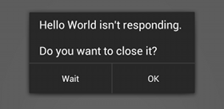
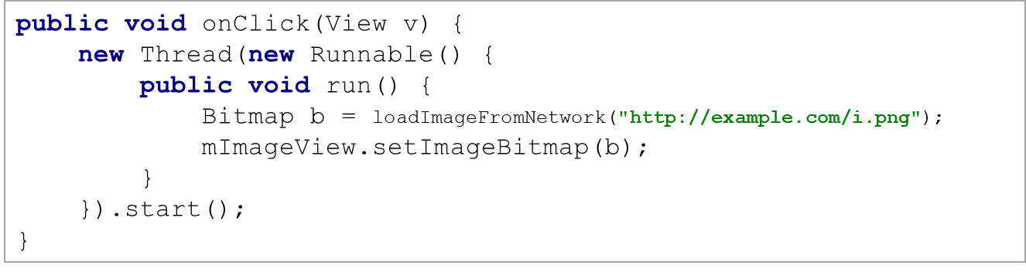
So … two lessons to remember
Do not block the UI thread
Do not access the Android UI toolkit from outside the UI thread.
Caution: Don’t run long running (5 sec+) task in the UI thread

Slide 17
Solutions

Slide 18
1. Access UI Thread from Other Threads
Use one of these three:
Activity.runOnUiThread (Runnable)
View.post (Runnable)
View.postDelayed (Runnable, long)
Runs in UI Thread
Runs in worker Thread
public void onClick(View v) { new Thread(new Runnable() { public void run() { final Bitmap bitmap = loadImageFromNetwork("http://example.com/image.png"); mImageView.post(new Runnable() { public void run() { mImageView.setImageBitmap(bitmap); } }); } }).start(); }

Slide 19
2. Async Task
Performs the blocking operations in a worker thread, and publishes the results on the UI thread.
public void onClick(View v) { new DownloadImageTask().execute("http://example.com/image.png"); } private class DownloadImageTask extends AsyncTask<String, Void, Bitmap> { /** The system calls this to perform work in a worker thread and * delivers it the parameters given to AsyncTask.execute() */ protected Bitmap doInBackground(String... urls) { return loadImageFromNetwork(urls[0]); } /** The system calls this to perform work in the UI thread and delivers * the result from doInBackground() */ protected void onPostExecute(Bitmap result) { mImageView.setImageBitmap(result); } }
Runs in worker Thread
Runs in UI Thread
http://developer.android.com/reference/android/os/AsyncTask.html

Slide 20
Summary
Executing a long running blocking task inside the click event freezes the UI.
Starting a new thread to do the blocking task solves the responsiveness problem, but the new thread cannot access UI elements declared in UI thread.
Using the UI element’s post() method solves the access problem, but now it again freezes the App.
Async Task solves all the problems. It executes doInBackground() on a worker thread and onPostExecute() on the UI thread.

Slide 21
References (study these)
http://developer.android.com/guide/components/processes-and-threads.html

Slide 22
Thread-safe methods and IPC
Make sure, when multiple threads can invoke a method, the method is thread-safe.
Android offers inter-process communication using remote procedure calls (RPCs)
Content Provider
Query(). Insert(), delete(), update()
Another
Activity

